Slide 1


Alumni Bridge
Major Project - II
CS - 805
Problem Statement: Implementation of Alumni Association System for the Institute.
Project Group Number: 29
Group Member Details:
Team Member 1 Name: Suyash Gupta
Branch : B-tech Stream: CSE Year: IV
Team Member 2 Name: Yash Girothia
Branch : B-tech Stream: CSE Year: IV
Team Member 3 Name: Palak Kumar Sharnagat
Branch : B-tech Stream: CSE Year: IV
Guide Details: Dr. Bhavana Gupta

Slide 2

Project Overview
AlumniBridge is a comprehensive Alumni Association platform developed for SISTec to foster stronger connections between the institute and its graduates. Designed as a web application, it offers seamless alumni registration, networking, and donation features. The platform enables alumni to connect based on shared interests, post and explore job opportunities, and participate in events and reunions. It also showcases success stories, promotes philanthropic support, and facilitates feedback and surveys for continuous improvement. By enhancing alumni engagement, promoting career growth, and nurturing a sense of belonging, AlumniBridge aims to create a thriving and supportive alumni community.

Slide 3
Technology stack:
Frontend: HTML, CSS, React.js
Backend: Node.js
UI/UX design: Figma
Database: MySQL
Version Control: GitHub

Slide 4
Functional Requirements
Non-Functional Requirements
Alumni registration and profile management.
Secure login and role-based access.
Networking and job portal.
Donation system and alumni directory.
Event management and success stories.
Feedback and surveys.
Usability: Intuitive and user-friendly interface.
Maintainability: Clean, modular code and design for easy updates and maintenance.
Compatibility: Works across modern web browsers.
Easy maintenance

Slide 5
Use Cases
Networking: Alumni use the web app to connect with batchmates or industry professionals.
Job Opportunities: Alumni explore job openings or post job listings.
Donations: Alumni contribute donations to support the institute.
Event Participation: Alumni register for reunions, webinars, or workshops.
Success Stories: Alumni share their achievements to inspire current students.
Feedback & Surveys: Alumni provide suggestions and feedback through the app.

Slide 6
Dependencies
MySQL: For storing alumni data, job postings, donations, and event details.
React.js: Frontend library for building the user interface.
Node.js: Runtime environment for executing server-side JavaScript.
Authentication Service: To manage user login and secure access
Payment Gateway: For processing donations securely.
Hosting Service: To deploy the web app.
Version Control: GitHub for code collaboration and version tracking.
Third-Party Libraries: For UI components, form validation, and styling (e.g., Bootstrap, Material-UI).

Slide 7
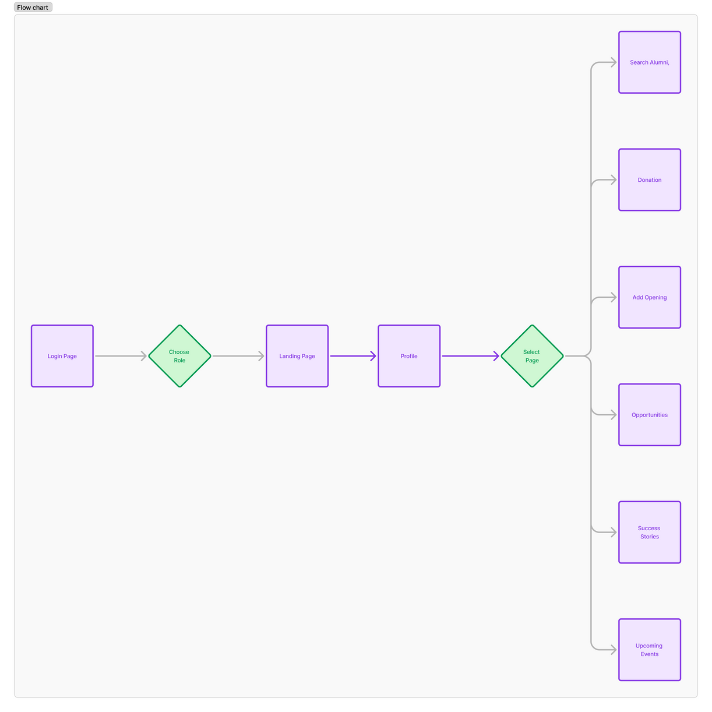

User flow

Slide 8
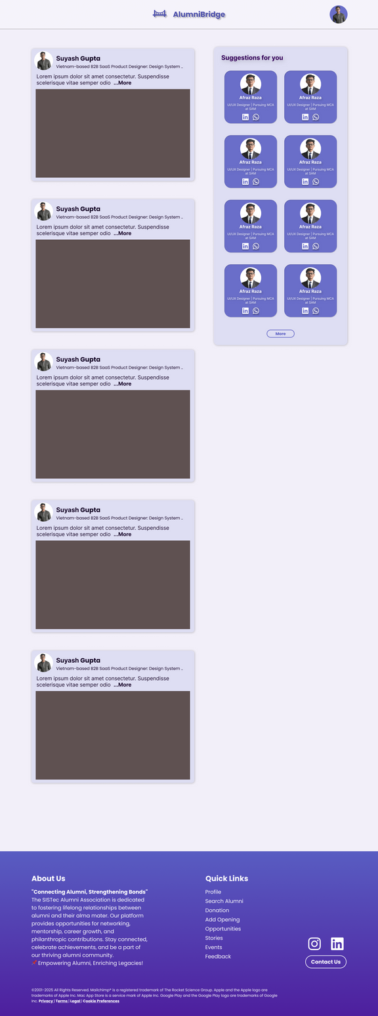
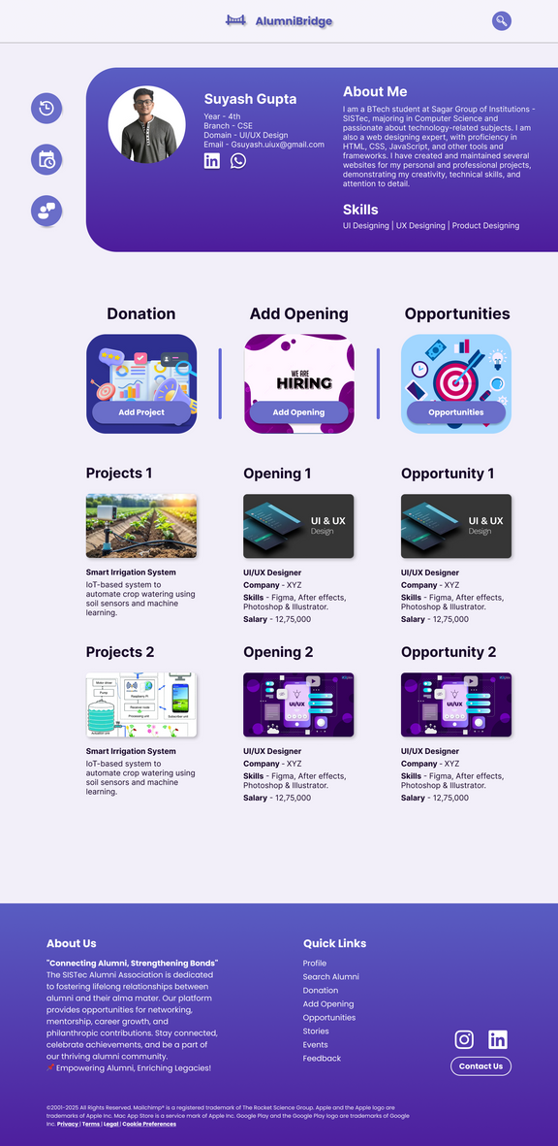
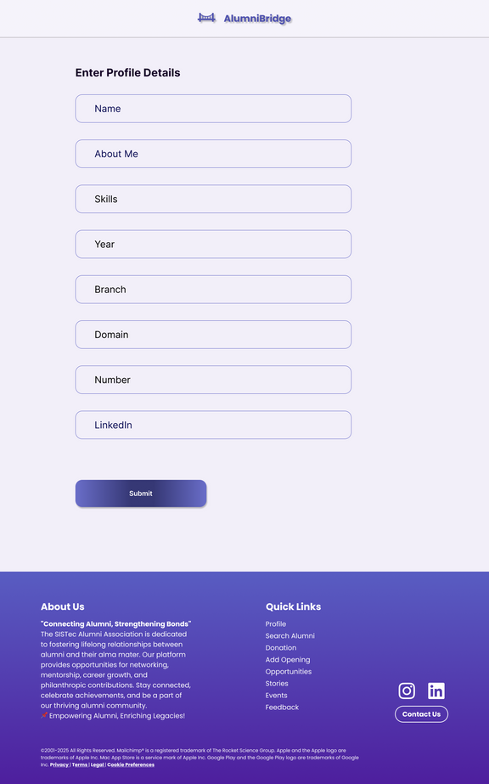
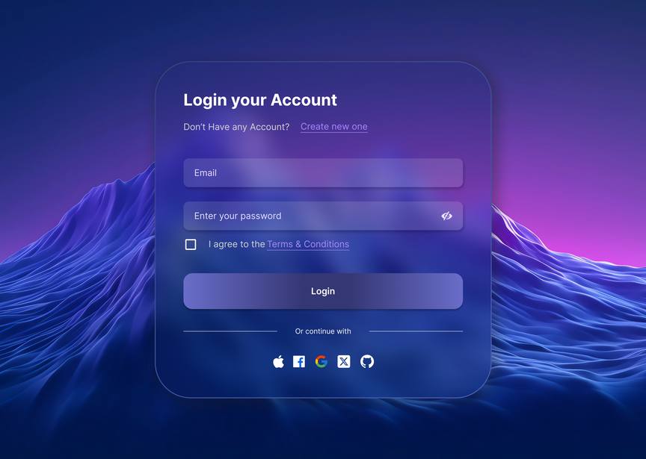
Output Screen

Slide 9
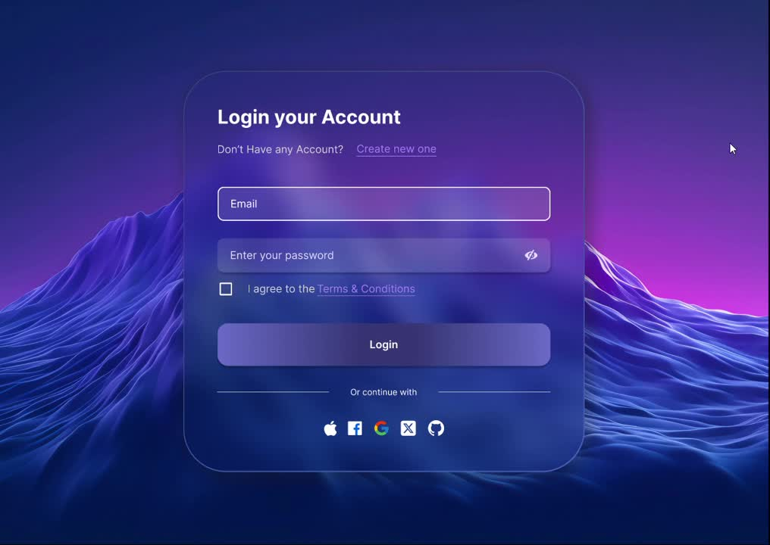
Project Prototype

Slide 10

Thank You!

